Slide 1
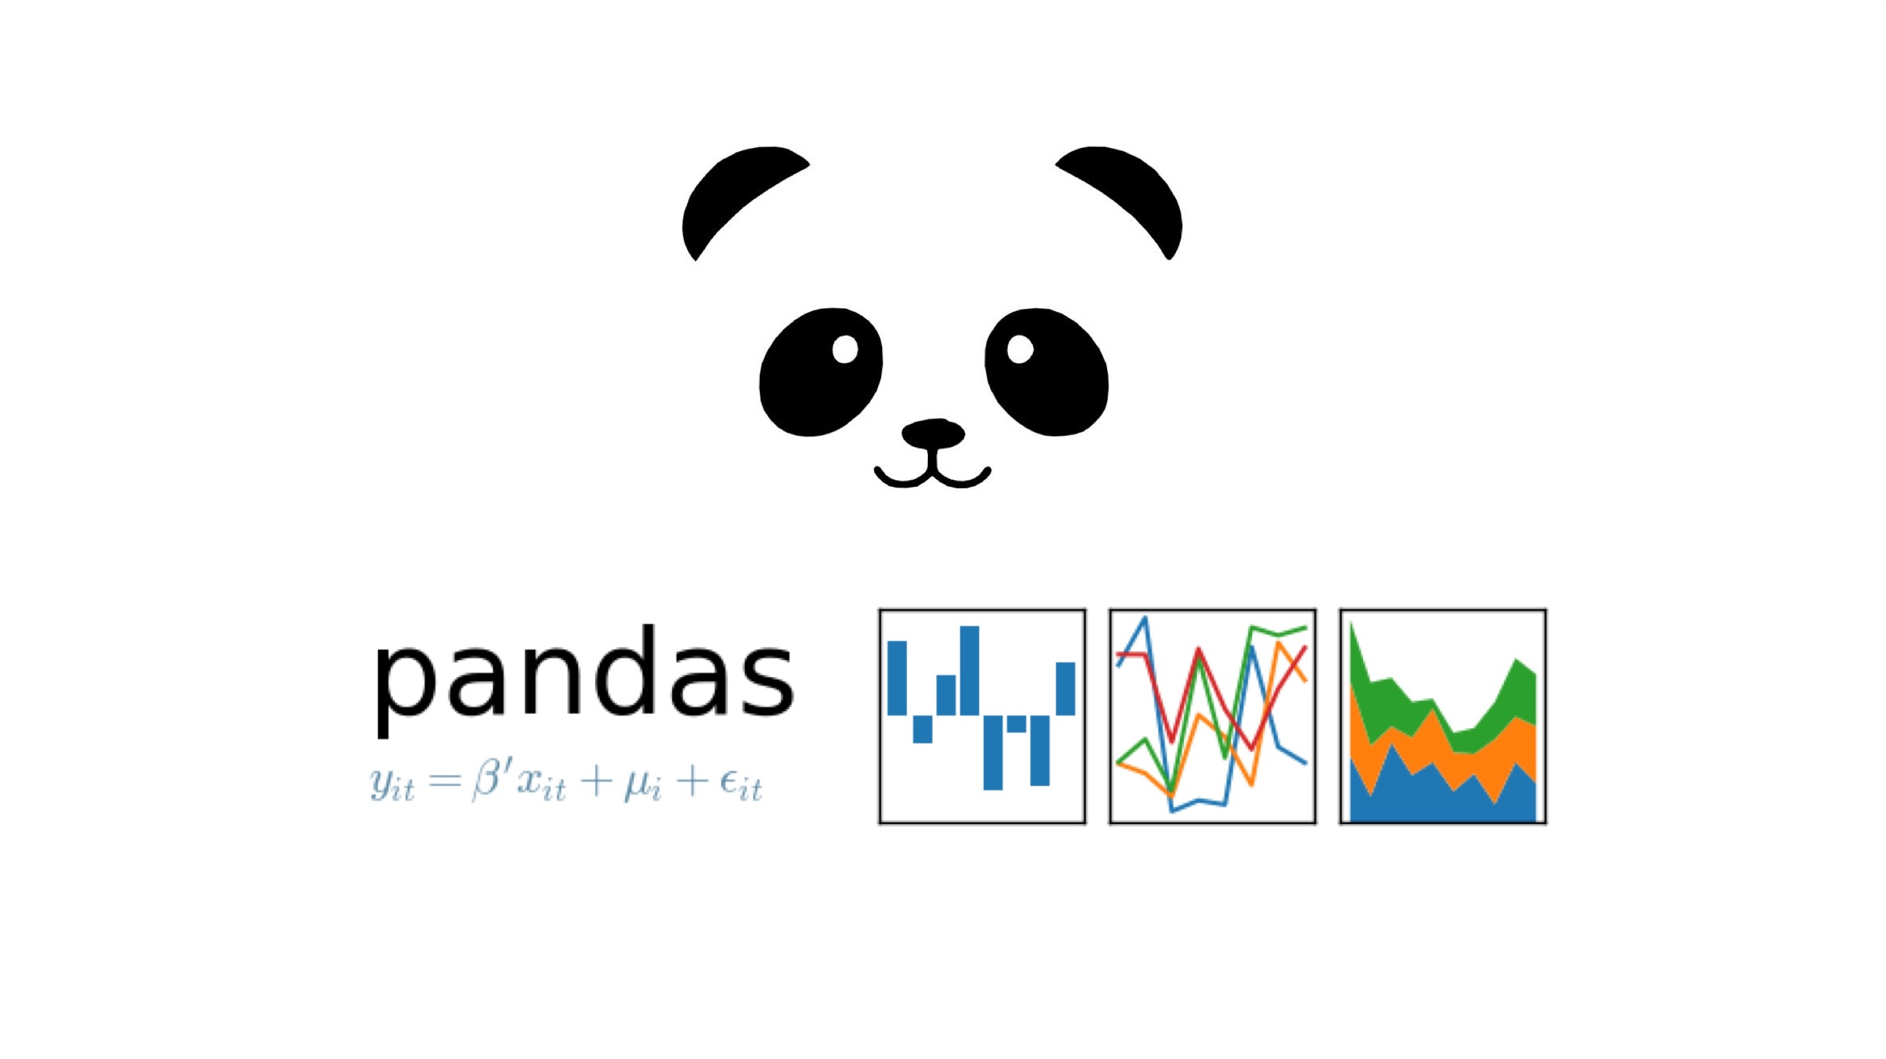
one of the best libraries for manipulation and visualization data

Slide 2
The topics we will cover in this presentation.
Installation and importation.
Why use the Pandas library?
Creation and usage of a Pandas Series.
Creation and usage of a Pandas DataFrame.
Basic operations on DataFrame objects.
Advanced operations on DataFrame objects.
Using Pandas for Deep and Machine Learning.

Slide 3
installation and importion
to had the pandas librarie to the vemv
import the libraries in your python project
NB: only if you use a local interpreter, if you work with Collab jupyter, Anaconda you only have to import them
#Put In the Terminal
pip install numpy
pip install pandas
#Import Python Libraries
import numpy as np
import pandas as pd

Slide 4
Why use the Pandas library?
Pandas is a popular Python library for data manipulation and analysis.
It offers efficient data structures, like DataFrames and Series, making it easy to handle and analyze large datasets.
With Pandas, you can clean and preprocess data, explore and analyze it, and integrate with other libraries. Its versatility, time series support, and flexibility make it a valuable tool for data scientists and analysts.

Slide 5
What is Pandas Series
Pandas Series is a labeled one-dimensional data structure offered by the Pandas library. Here's why to use Pandas Series
Flexibility: Pandas Series can hold data of different types, including numbers, strings, and dates. This allows for efficient storage and manipulation of heterogeneous data
Indexing: Each element in a Pandas Series is labeled with an index, enabling quick and easy access to data. The index can be used for selection, filtering, and grouping operations on the data
Advanced Functionality: Pandas Series offers a wide range of advanced features for data manipulation. This includes mathematical operations, transformation functions, boolean operations, date manipulations, and more.
Integration with other Pandas features: Pandas Series seamlessly integrates with other Pandas data structures, such as DataFrames. This allows for performing complex operations on complete datasets.

Slide 6
Exemple of a Pandas Series in Code
Creation the Data Series Object
Result Output
In this example, we create a series "grades" containing student grades. When we print the series, we get the values along with their respective indices. In this case, the indices range from 0 to 4, and the values are the corresponding grades.
# Creating a series with student grades
grades = pd.Series([85, 90, 75, 92, 88])
# Printing the series
print(grades)
0 85
1 90
2 75
3 92
4 88
dtype: int64

Slide 7
Next Exemple of a Pandas Series in Code
Initialize Dictionary of student names and their corresponding grades
Result Output
In this example, we have a dictionary where the keys represent student names and the values represent their corresponding grades. We use the dictionary to create a Pandas Series called grades_series. When we print the series, we see the student names as the indices and their grades as the values.
# Dictionary of student names and their corresponding grades
grades_dict = {'Alice': 85, 'Bob': 90, 'Charlie': 75, 'David': 92, 'Emily': 88}
# Creating a series from the dictionary
grades_series = pd.Series(grades_dict)
# Printing the series
print(grades_series)
Alice 85
Bob 90
Charlie 75
David 92
Emily 88
dtype: int64

Slide 8
Usage of panda series in code
Accessing values: You can access the values of the series using positional indexing
Accessing indexes: You can access the indexes of the series using the index property.
Mathematical operations: You can make mathematical operations on the series, for example, adding a value to each grade
Filtering data: You can filter the series based on certain conditions to select specific values.
Checking for value presence: You can check if a specific value is present in the series using the in operator.
print(grades_series[0]) # Access the first value of the series (85)
print(grades_series.index) # Print the indexes of the series
updated_grades = grades_series + 5 # Add 5 to each grade
filtered_grades = grades_series[grades_series > 80]
# Filter grades greater than 80
print('Alice' in grades_series) # Check if 'Alice' is present in the series (True)

Slide 9
Usage of panda series statistics and plot
Getting statistics: You can obtain summary statistics of the series using methods like mean, min, max, sum, standard deviation, variance...
Data Visualization: Pandas Series can be used to create plots and visualizations.
print(grades_series.mean()) # Calculate the mean grade
print(grades_series.min()) # Find the minimum grade
print(grades_series.std()) # Calculating standard deviation
print(grades_series.var()) # Calculating variance
import matplotlib.pyplot as plt
grades_series.plot(kind='bar')# Plot a bar chart of the series values
plt.show() # Show the Data
NB: There are numerous different ways to graphically represent data. To gain a better understanding of graphic libraries, please be patient and wait for the introduction to Matplotlib or Seaborn

Slide 10
What is pandas DataFrame
A Pandas DataFrame is a two-dimensional labeled data structure with rows and columns.
It can hold data of different types in each column and is similar to a table in a relational database.
It is ideal for working with multiple sets of related data and performing operations that involve multiple columns.
In summary, while Pandas Series is designed for one-dimensional data, Pandas DataFrame is designed for working with two-dimensional tabular data, providing more versatility and functionality for handling complex datasets with multiple variables.
the Pandas DataFrame is a more powerful tool than a Pandas Series because it provides a tabular data structure, data flexibility, advanced manipulation capabilities, and seamless integration with other data analysis libraries. It is an ideal choice for analyzing, manipulating, and transforming complex data.

Slide 11
Creation and Usage on DataFrame
the most common ways to create a DataFrame
Hard coding the data:
Converting a Pandas Series into a DataFrame:
Reading a CSV file to create a DataFrame
in code
data = {'Name': ['Alice', 'Bob', 'Charlie'],
'Age': [25, 30, 35],
'City': ['Paris', 'London', 'New York']}
df = pd.DataFrame(data)
output
Name Age City
0 Alice 25 Paris
1 Bob 30 London
2 Charlie 35 New York
output
Grades
0 85
1 90
2 75
3 92
4 88
in code
series = pd.Series([85, 90, 75, 92, 88],name='Grades')
df = pd.DataFrame(data)
in code
df = pd.read_csv('name_file.csv') # the output depend the csv files

Slide 12
Basics operation on DataFrame
Once the DataFrame is created and contains data, there is a long list of functions that we can call to help us examine our dataset. Here are some commonly used functions:
head(n): Displays the first n rows of the DataFrame.
tail(n): Displays the last n rows of the DataFrame.
info(): Displays information about the DataFrame, including data types and the number of non-null values.
describe(): Provides descriptive statistics for the numeric columns of the DataFrame, such as mean, standard deviation, etc.
shape: Returns the number of rows and columns in the DataFrame.
columns: Returns the list of column names in the DataFrame.
index: Returns the index of the DataFrame
unique(): Returns the unique values in a column of the DataFrame.

Slide 13
Advance operation on DataFrame
loc[row_index, col_index]: Accesses a specific value using label-based indexing.
iloc[row_index, col_index]: Accesses a specific value using positional indexing.
drop(labels): Removes specified rows or columns from the DataFrame.
# The drop(labels) function is extremely important, and we will come back to this function later in the practical case.
fillna(value): Fills missing values with a specified value.
groupby(column): Groups the data based on values in a specified column
sort_values(column): Sorts the DataFrame based on values in a specified column
value_counts(): Counts the occurrences of each value in a column of the DataFrame.
# This has the merit of existing, but it is not very conclusive in the case of real datasets.
apply(func): Applies a specified function to a column or DataFrame.

Slide 14
Advance operation on DataFrame
So far, we have seen the different functions that allow us to examine the dataset, such as displaying the first/last rows, obtaining statistical information about the data, and performing various operations like selecting a specific row, column, or cell
Now we will present specific operations with one or multiple DataFrames.
merge(df1, df2): Merges two DataFrames based on common columns.
concat([df1, df2]): Concatenates multiple DataFrames along a specified axis.
pivot_table(): Creates a pivot table from the DataFrame data.
plot(): Generates plots and visualizations from the DataFrame data.
Now that we have all the necessary tools to examine and work with datasets, we will explore concrete examples on a real dataset in the next slides.

Slide 15
We have discussed enough, it's time to see the concrete implementations on a real dataset.
I have chosen to do this using the Iris CSV dataset
what is the Iris Data Set
The Iris dataset is a popular and well-known dataset in the field of machine learning and statistics. It was introduced by the British statistician and biologist Ronald Fisher in 1936. The dataset contains measurements of various attributes of three different species of Iris flowers: Setosa, Versicolor, and Virginica. The attributes include sepal length, sepal width, petal length, and petal width.
The goal of analyzing the Iris dataset is typically to explore the relationship between these attributes and the different Iris species. By examining the measurements, researchers aim to understand the patterns and differences among the species and potentially develop classification models to distinguish between them based on the attribute values.
The Iris dataset is often used as a beginner's dataset in machine learning and data analysis due to its simplicity and well-defined classes. It serves as a great example for learning various data analysis techniques, data visualization, and classification algorithms.

Slide 16
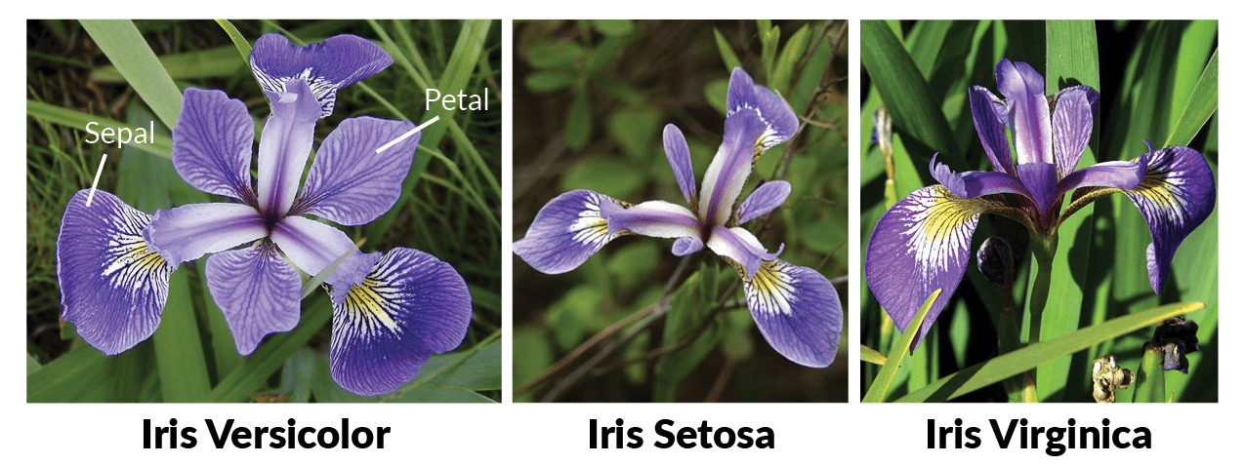
Image of the different flower varieties in the Iris dataset

Slide 17
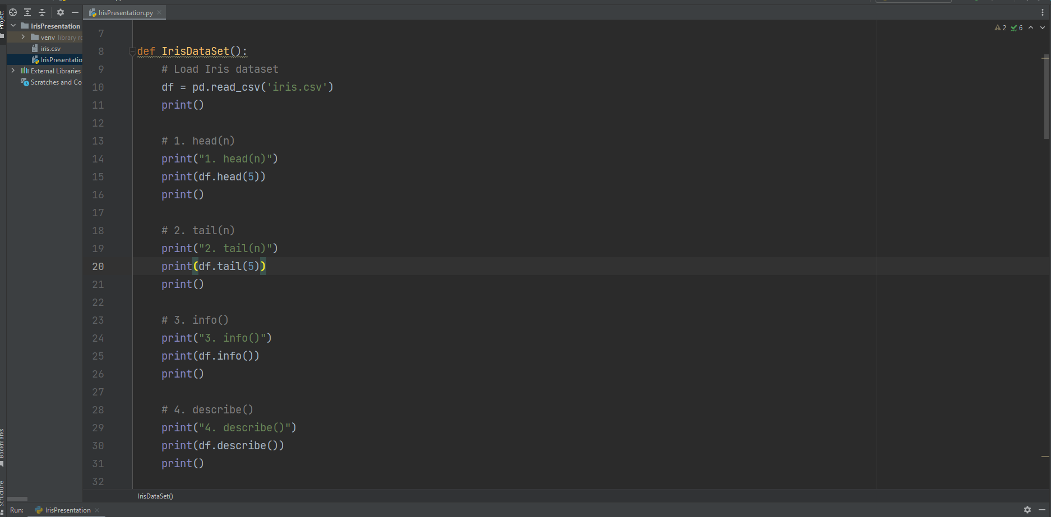

Slide 18
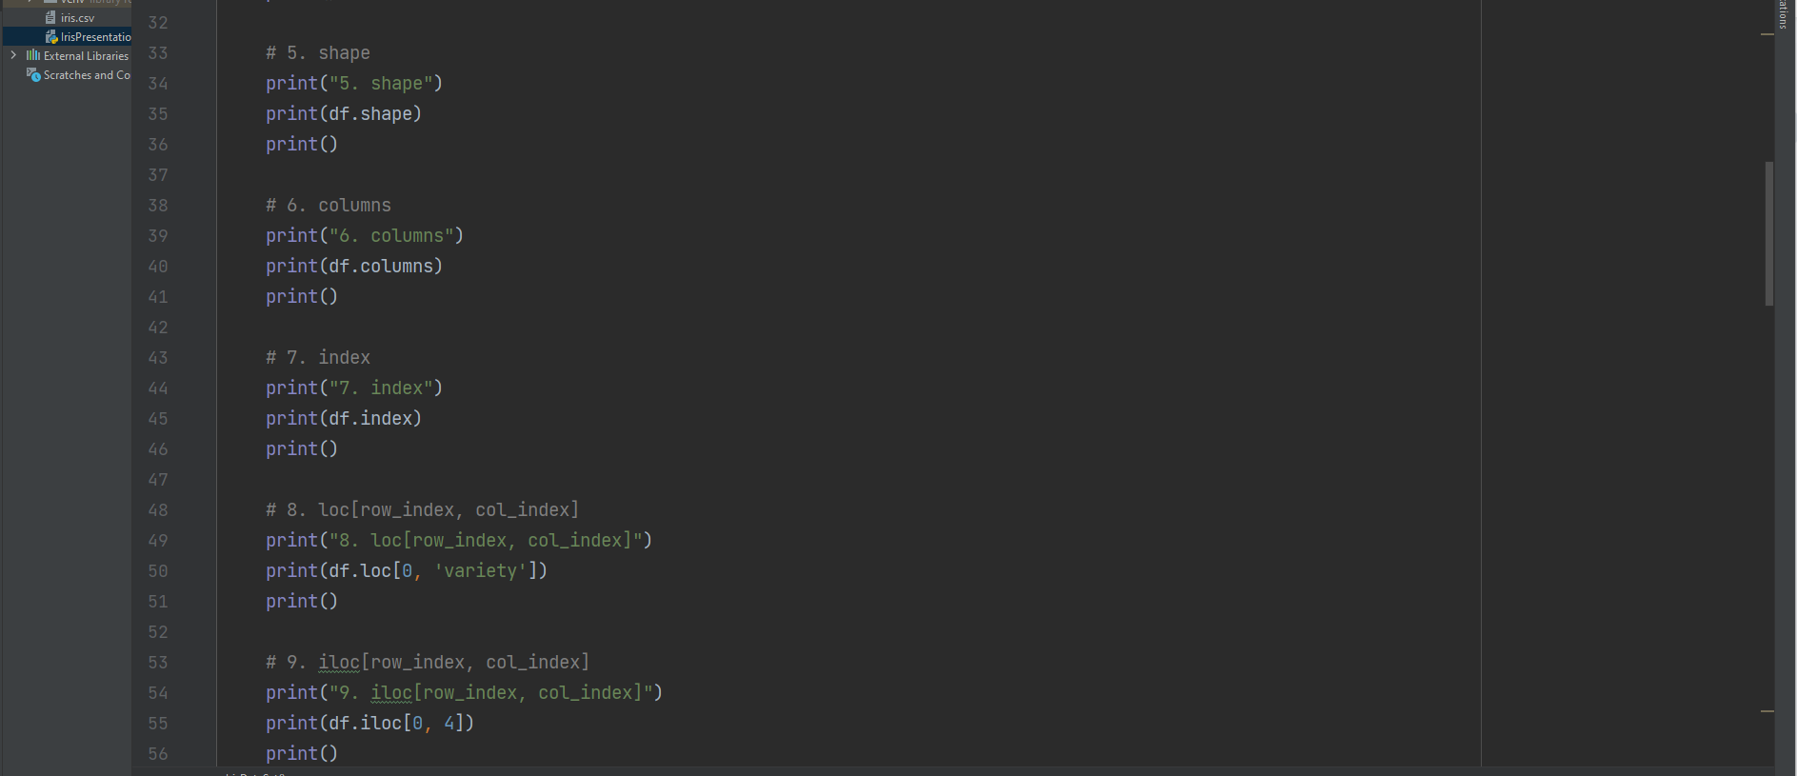

Slide 19
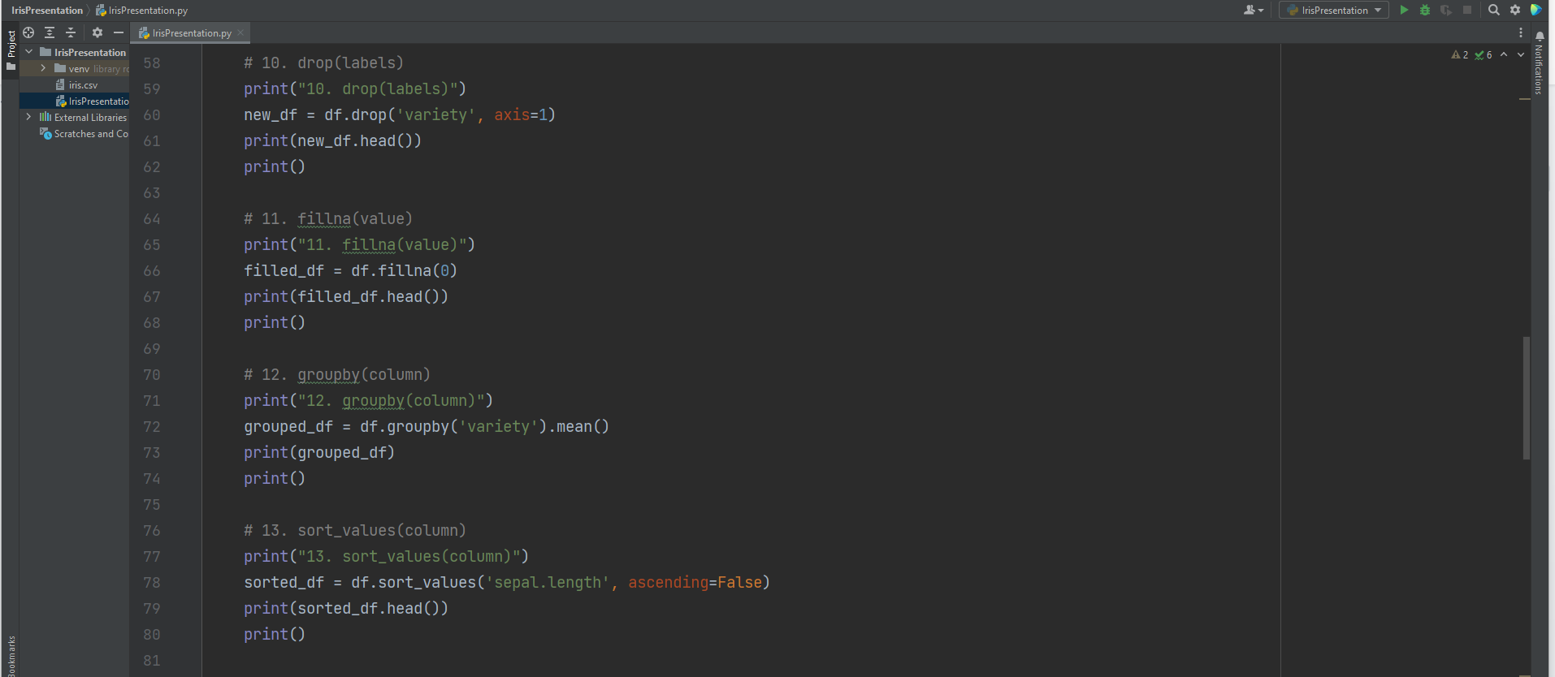

Slide 20
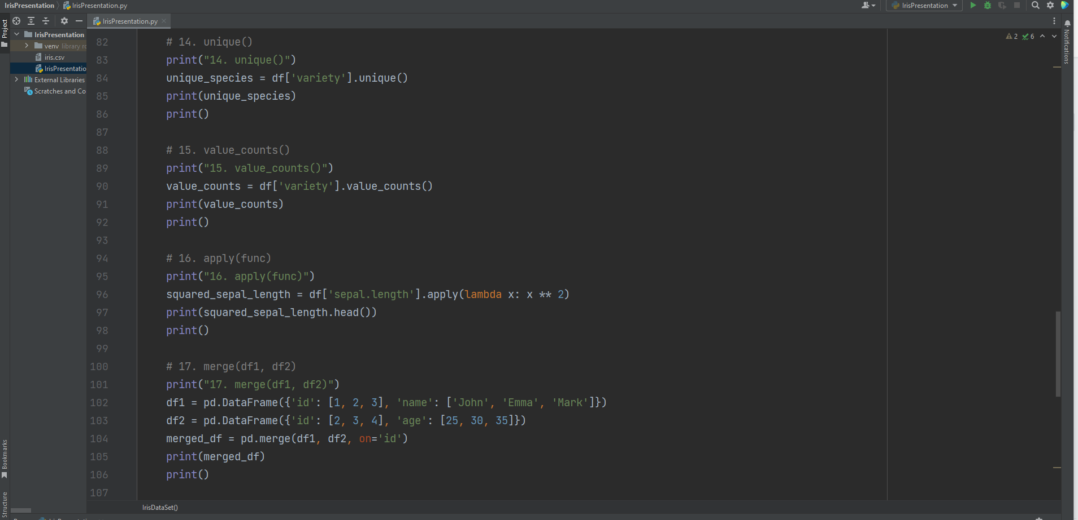

Slide 21
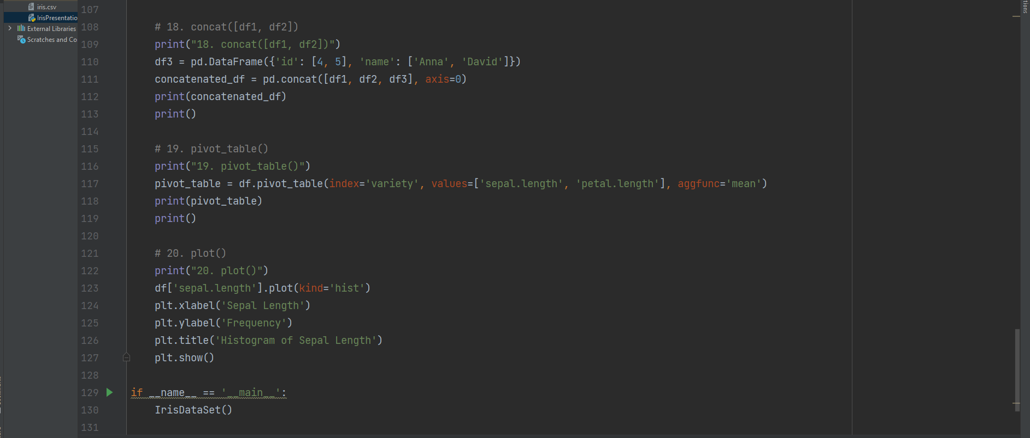

Slide 22
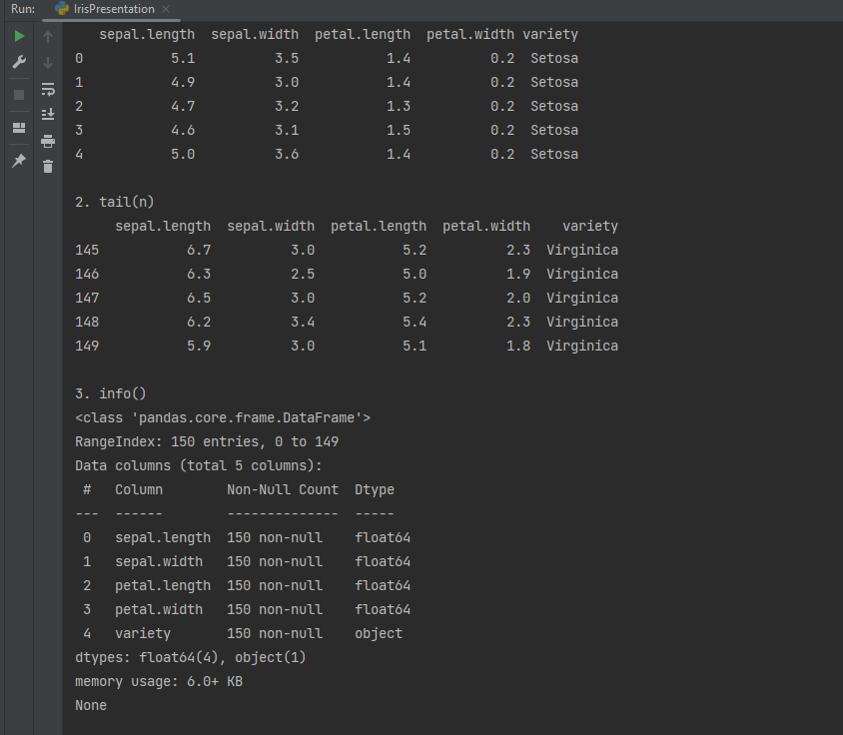
Output Code Results

Slide 23
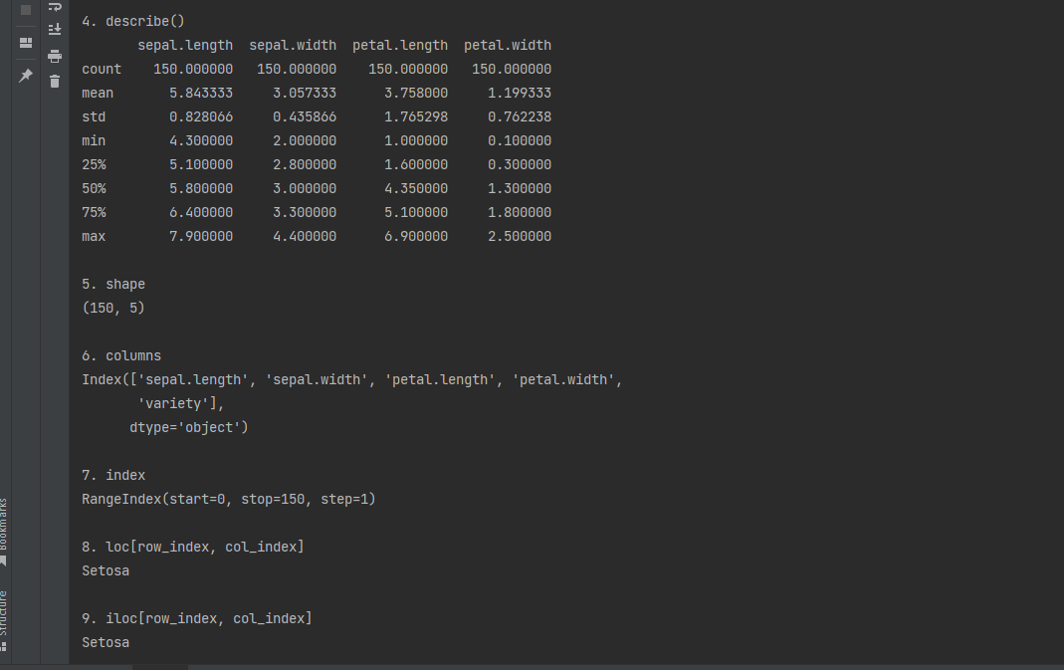

Slide 24
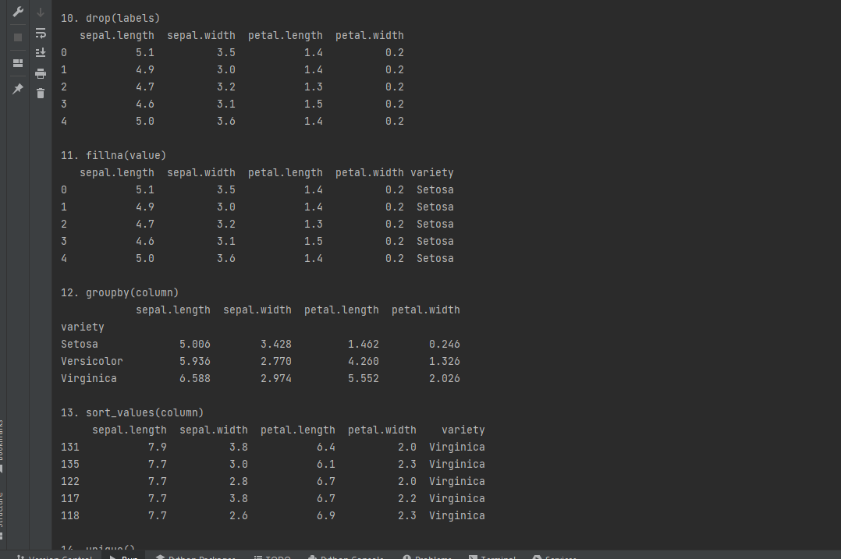

Slide 25
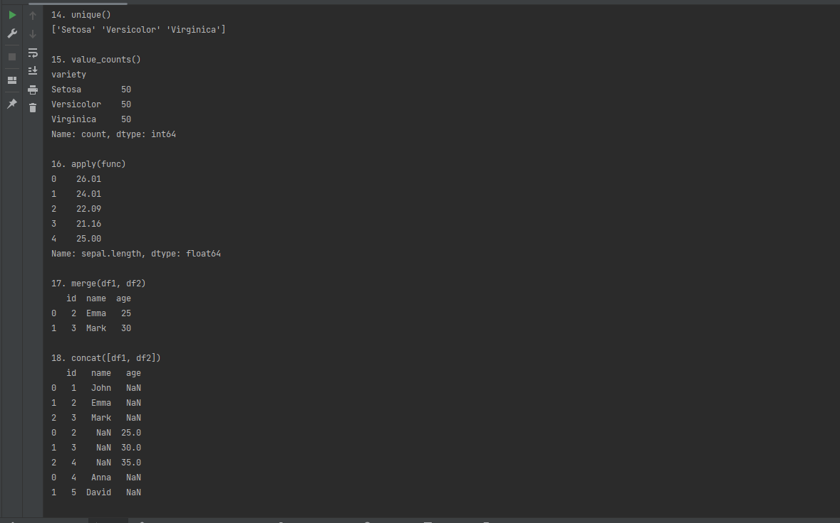

Slide 26
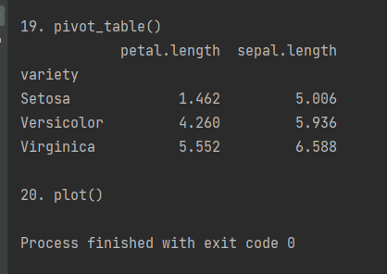
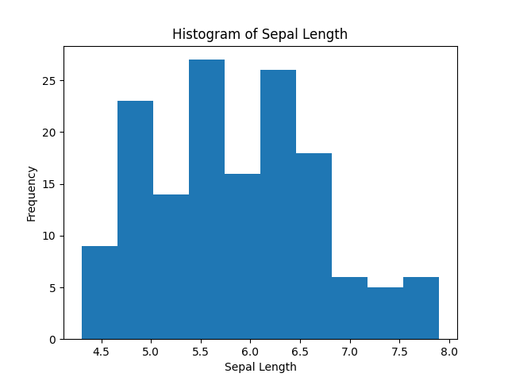
Plot the data

